Slide 1
AUTO INSURANCE FRAUD DETECTION
Harika Tumula – 700741664
Ravali Bhoothpuram - 700742316

Slide 2
Roles
We have established this method through zoom calls, screen sharing was conducted among the developer navigator pairs. The developer will share the screen while the navigator views it and gives suggestions or feedback, and the developer instantly applies the ideas that are shared by the navigator in code to improvise. Other than this pair programming we also followed the scrum method. We have assigned tasks and shared work equally.
We have conducted meetings every week to exchange the status update and assign new tasks for the following week. This approach helped us in finishing our work and meet the deadlines assigned.

Slide 3
Responsilities
Our approach includes comparison of various supervised machine learning models to check which algorithm performs efficiently in categorizing fraud insurance claims.
To achieve this data is first evaluated for biasing issues before model creation because most fraud detection datasets are imbalanced, and this biasing is addressed using SMOTE (Synthetic Minority Over Sampling Technique). Using the python module scikit learn, this balanced dataset is then utilized to train several machine learning algorithms and various metrics like accuracy, F1-score are calculated.
Further to improve accuracy, hyper tuning of parameters using random grid search is done to check for optimal parameters. The metrics of multiple models are compared using this parameter, and the model with overall better performance is stored in a pickle file.

Slide 4
Motivation
Keeping in mind giving something useful to society, we have tried to implement a system using machine learning that helps to detect automobile insurance frauds. As per the insurance information institute, it is shown that only 3% of the fraud vehicle insurance cases have been detected and it would be a huge improvement for the auto insurance company. Hence, our system can benefit both the users to claim auto insurance and the car insurance companies to avoid payments to fraud cases to save money and time.

Slide 5
Objectives
⦁ The dataset generated from the Kaggle is preprocessed and transformed data is accessible to the public where they can easily download and apply models to detect insurance frauds.
⦁ We are applying four different machine learning models to find the most accurate model to detect the insurance claims.
⦁ In future companies can use directly use this model and detect frauds.

Slide 6
Related work
The purpose of our project is to help insurance companies to detect fraud insurance claims to avoid unethical and unnecessary payments to the false claims.
In order to achieve this goal, we need to build machine learning models to have the ability to determine whether it is a false claim or not based on the input insurance claim data.
Hence, we need data about each claim in terms of information about the insurance claimer like income, age, education and claim history, as well as information about the car like car type, car usage purpose and car age. During our literature survey, we found this dataset from Kaggle including information of details about each claim.

Slide 7
Related work
In order to get our data ready for further analysis and model building, we first check for missing values. Also, we check box plot for each feature for outlier value and we find outliers exist in feature ‘umbrella limit’ which is handled later in the data transformation section. As for duplication, there are no duplicate data entries in our dataset.
To ensure random sampling of data selection each time, we use train test split function to select training and testing data with random state equals 20.

Slide 8
Related Work
During the exploration of our dataset, we also found several columns have too many unique values and it is not helpful for us to build a generalized model, so we decide to drop column ‘incident location’, ‘policy bind date’, ‘insured zip’, ‘incident date’, ‘authorities contacted’, ‘auto make’, ‘auto model’ to perform feature reduction.
Last, we transform non-numerical data to numerical data by encoding so all data fields are in numerical type in order to visualize and build machine learning models.

Slide 9
Related work
To get a better understanding of the dataset, we use the ‘describe’ method to get a statistical report. For numerical data types, we find the mean, std, min and max value. For object data types, we find the unique value count and top value frequency.
To gain a deeper understanding of relations of each parameter with fraud claims, we conduct more visualizations.

Slide 10
Problem Statement
To accurately forecast fraud insurance claims, which is a classification problem using the labeled data, we used supervised learning algorithms to see which one best suit for detecting automobile insurance fraud and assisting organizers in reducing losses.

Slide 11
Proposed Solution
We tried five different machine learning models to detect the best accurate model for our project. First, we compared all the models without applying any tuning, the accuracy score of all the models obtained was mostly high which indicates low bias.
However, we cannot simply rely on accuracy as our dataset was biased which was also evidence from specificity and Cohen Kappa score of models.
After SMOTE dataset was balanced having equal number of both the classes, using this dataset we ran all the model again and compared various metrics, this time accuracy was increased as compared to first case.

Slide 12
Proposed Solution
Also, we can see improvement in Cohen Kappa which tells that accuracy is not by chance, but it is actual accuracy of your model. Then we also concentrated on F1 score of models and precision score as our main aim was to detect fraud cases and precision is one metric which tells us how many fraud cases were correctly detected.
In this comparison we finally chose SVM, Random Forest and XGboost as all of them were performing better. Lastly, we compared models and checked for Cohen Kappa, F1 score and precision recall curve to select the best model in detecting fraud cases.

Slide 13
Proposed Solution
Cohen kappa score for imbalanced data is below 50%. So, used synthetic minority over sampling technique (SMOTE) to handle the imbalanced dataset. Using the standard scaler method scaled down all the input values.
After SMOTE we have done hyper tuning and applied it to all models. So, performance metrics for all five models without sampling, with SMOTE and with hyper tuning has been done and noted. Considering all these scenarios one best high-performance model will be chosen for detecting insurance frauds.

Slide 14
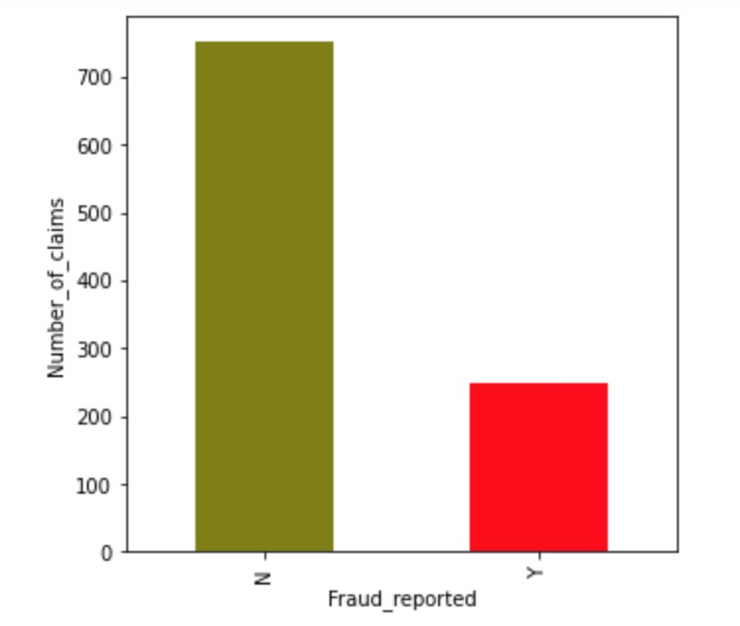
ax = pd.value_counts(df['fraud_reported']).plot.bar(color=['olive', 'red'], figsize=(5,5)) ax.set_xlabel('Fraud_reported') ax.set_ylabel('Number_of_claims') plt.show()
Figure 4. Number of claims vs Fraud Reported

Slide 15
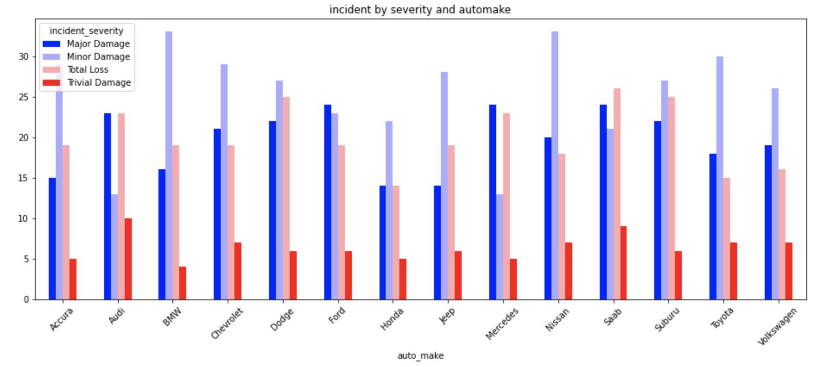
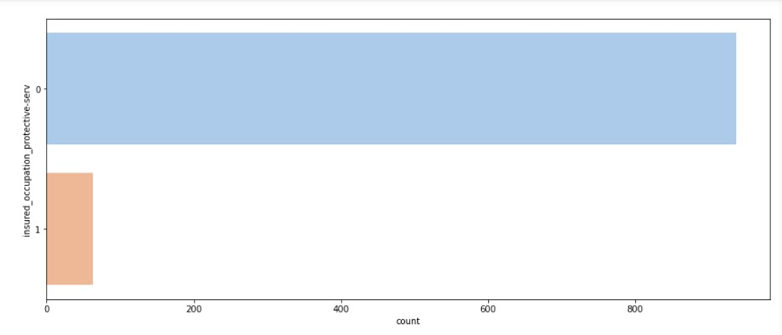
Figure 5. Incident Severity vs Auto Made
Figure 6. Insurance Occupation vs Fraud Count

Slide 16
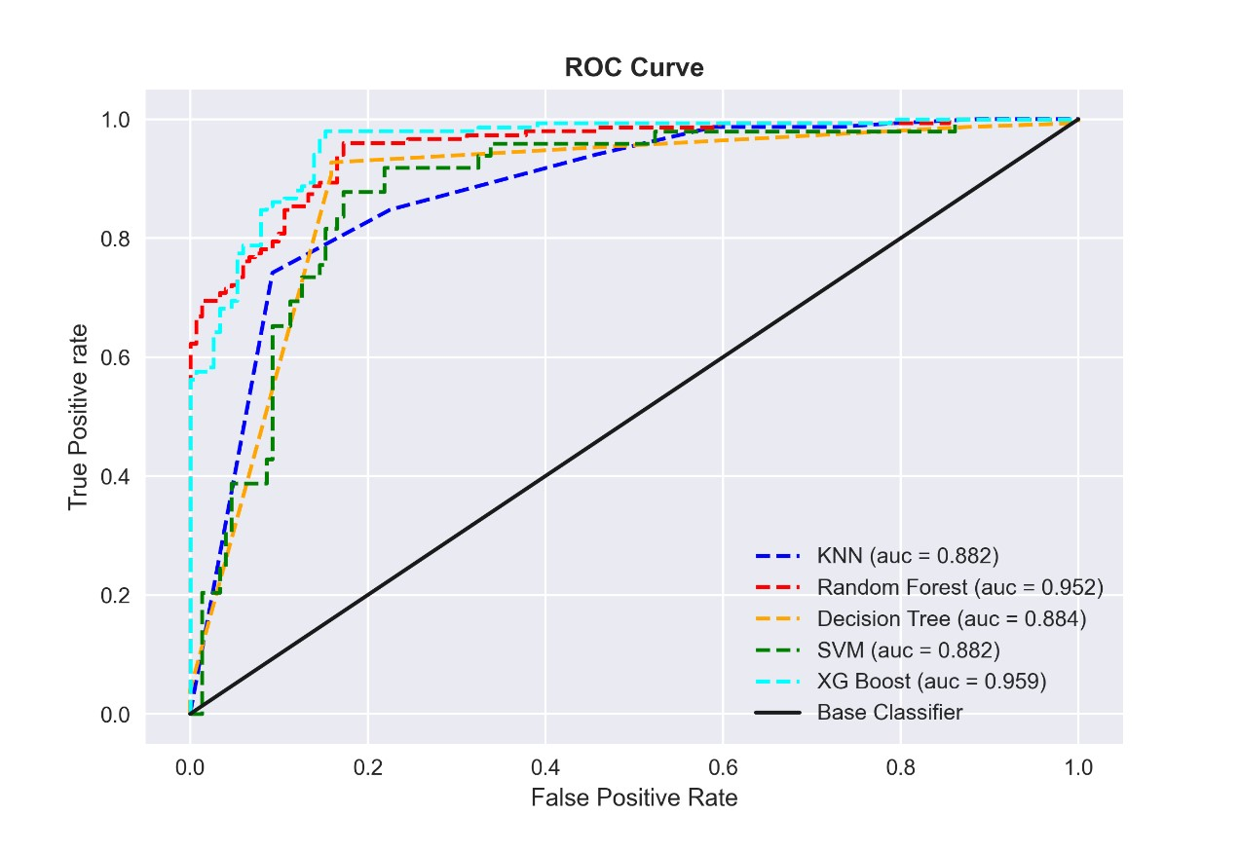

Slide 17
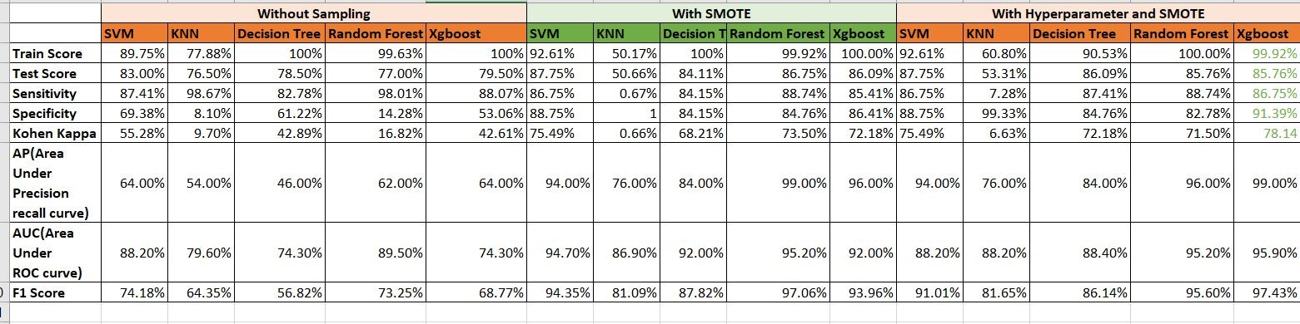
Below table summarizes the metrics of all models developed in this project:
Figure 14. Metrics of All Models

Slide 18
References
[1] Khatri, S., Arora, A., and Agrawal, A. (2020). Supervised machine learning algorithms for credit card fraud detection: a comparison. IEEE, 10th International Conference on Cloud Computing, Data Science & Engineering (Confluence), 680–683.
[2] Dua, D., & Graff, C. (2019). UCI machine learning repository. Retrieved September12, 2019, from http://archive.ics.uci.edu/ml.
[3] Arenz, O., Zhong, M., and Neumann, G. (2020). Trust-Region variational inference with Gaussian mixture models. Journal of Machine Learning Research, 21(163), 1-60.
[4] Van Engelen, J. E., and Hoos, H. H. (2020). A survey on semi-supervised learning.Machine Learning, 109(2), 373–440.

Slide 19
THANK YOU

